Slide 1
Wi-Fi
Presented by:
Maimoona khilji
Khurram Ali Dar
Laiba Humayun khan

Slide 2
01
Table of Contents
02
03
04
05
06
07
08
09
Wifi
IEEE 802.11 And The Standards Body
Wi-Fi Standards
Internet vs Wi-Fi
Wlan vs Wi-Fi
Elements of a WI-FI Network
How Wi-Fi works?
Wi-Fi Network Topologies
Applications

Slide 3

WiFi
Wi-Fi is the type of wireless technology used in computer networking..
The wireless part of network is often called wlan.
Wi-Fi is the radio signal.
it is used for mobility.
Notes:
Wi-Fi is the wireless technology used to connect computers, tablets, smartphones and other devices to the internet. Wi-Fi is the radio signal sent from a wireless router to a nearby device, which translates the signal into data you can see and use.

Slide 4
Wi-Fi stands for:
It is often thought to be short for Wireless Fidelity.
The term was created by a marketing firm.

Slide 5
IEEE 802.11 And The Standards Body
IEEE (Institute of Electrical and Electronics Engineers). These are the people who sit around and decide things like how many bits are in a byte and the standards for encryption. They’re not going to come to a company’s house and take their lunch money if they don’t comply, but companies participate and go along with that the IEEE standards decides so their things work well together.

Slide 6
IEEE 802.11 And The Standards Body
From this group, we get the various flavors of Wi-Fi. They’re all called the IEEE 802.11 standard with the letter after the 802.11 numbers. The usual rule is the higher the letter, the faster the speed of the network. Almost all of these function over a range of about 30 meters (150 feet).
Speed: This is calculated in Mbps (1 million bits per second)
Frequency: These are either 5 Ghz or 2.4 Ghz.
Here’s a Wi-Fi standards chart of each 802.11 standards type based on its designation

Slide 7
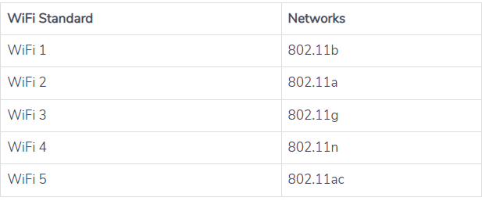
Wi-Fi Standards

Slide 8
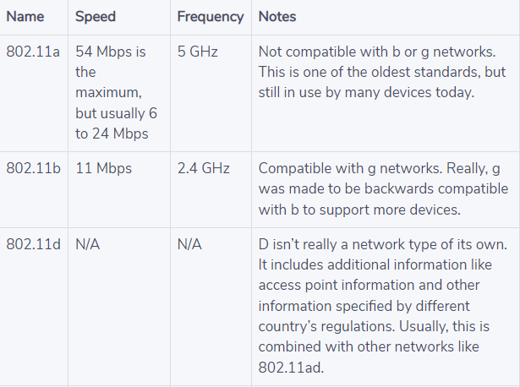
Standards of Wi-Fi

Slide 9
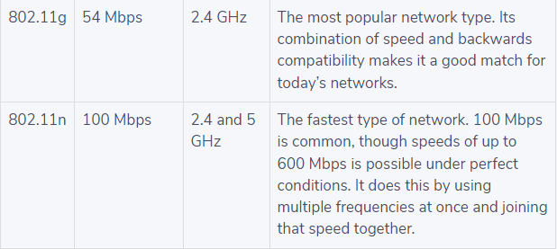
Standards of Wi-Fi

Slide 10
Internet vs Wi-Fi
The Internet is a process that allows one device to send and receive data or information from another device over the Internet Protocol. On the other hand, Wi-Fi is more like an object that can provide wireless Internet access for laptops, smartphones, PCs, or other devices within a certain range.
In simple words we can say that Wi-Fi is nothing but it is a medium of transferring the data from one device to another.

Slide 11
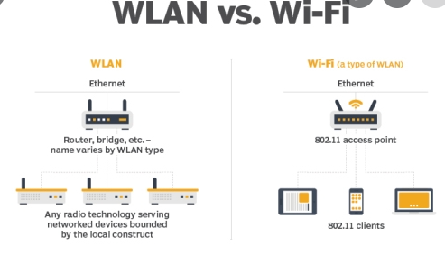
Wlan vs Wi-Fi
Wireless local area networking, also known as WLAN or wireless LAN, is a term for using wireless digital signals to connect computers and other devices. One of the most common wireless LAN technologies now in use is Wi-Fi, which refers to a set of standards for how devices can talk to each other on wireless networks

Slide 12



Elements of a WI-FI Network
Access Point (AP)
Wi-Fi cards
Safeguards
Notes:
Access Point is a networking hardware device that allows other Wi-Fi devices to connect to a wired network
Access Point (AP) - The AP is a wireless LAN transceiver or “base station” that can connect one or many wireless devices simultaneously to the Internet.
Wi-Fi cards - They accept the wireless signal and transmit information. They can be internal and external. (e.g PCMCIA Card for Laptop and PCI Card for Desktop PC)
Safeguards - Firewalls and anti-virus software protect networks from uninvited users and keep information secure.

Slide 13







End User Devices
How Wi-Fi works?
Internet
Fiber Cable
Radio Waves
Wireless Router
Analog Line
Modem
Notes:
Wi-Fi network is build with several hardware components like
wireless access points or routers
End-user devices like mobiles phones, laptop, tablets etc. which are equipped with Wi-Fi Adapter
On the other hand, the wireless router is connected to the internet via physical connection that is
fiber cable
analog line
this then uses telephone and modem which is then connected to the wireless router.
A modulator and demodulator is needed for analog-to-digital and digital-to-analog signal conversion
The Wi-Fi router then connects to the end devices via radio waves to establish an end-to-end internet
Here the wireless router receives the data from the internet, translates it into the radio signals and send it over the wireless network to the connected devices
The same process also happens in reverse.
• A single access point can support up to 30 users and can function within a range of 100 – 150 feet indoors and up to 300 feet outdoors. • Many access points can be connected to each other via Ethernet cables to create a single large network.
How does WIFI work
The router is the key piece equipment in a wireless network. The router is physically connected to the internet by an Ethernet cable. The router then broadcasts the high frequency radio signal. The signal then carries data to and from the internet.
Then there is the adapter. The adapter in whatever device you are using both picks up the signal from the router, and also sends data back to your router and onto the the internet creating an upstream and downstream activity.

Slide 14
Wi-Fi Network Topologies

Slide 15
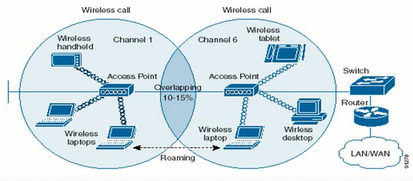
AP-based topology
The client communicate through Access Point.
Notes:
Wireless Access Point (AP) separates wired LAN and wireless LAN. Wireless Access Point (AP) is connected to the wired LAN. Wireless Access Point (AP) receives data from wired Ethernet LAN, and converts those data into wireless signals.

Slide 16
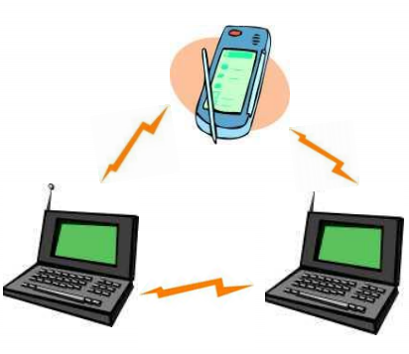
Peer-to-Peer topology
Client devices communicate directly with each other.
Notes:
AP is not required.
Client devices within a cell can communicate directly with each other.
It is useful for setting up of a wireless network quickly and easily.

Slide 17

Point-to-Multipoint bridge topology
Connection of one LAN to other LANs
Notes:
This is used to connect a LAN in one building to LANs in other buildings even if the buildings are miles apart. These conditions receive a clear line of sight between buildings.
The line-of-sight range varies based on the type of wireless bridge and antenna used as well as the environmental conditions.

Slide 18
Applications

Slide 19
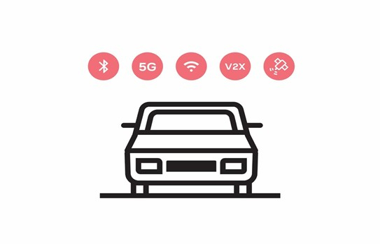
Wi-Fi Automotive

Slide 20
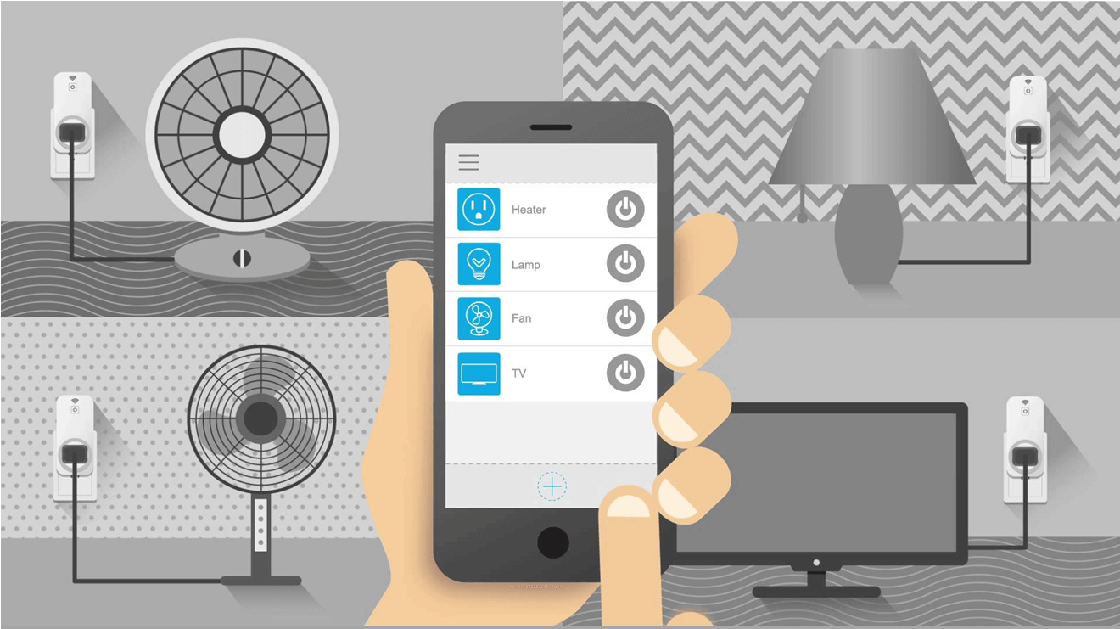
Wi-Fi Home Automation

Slide 21
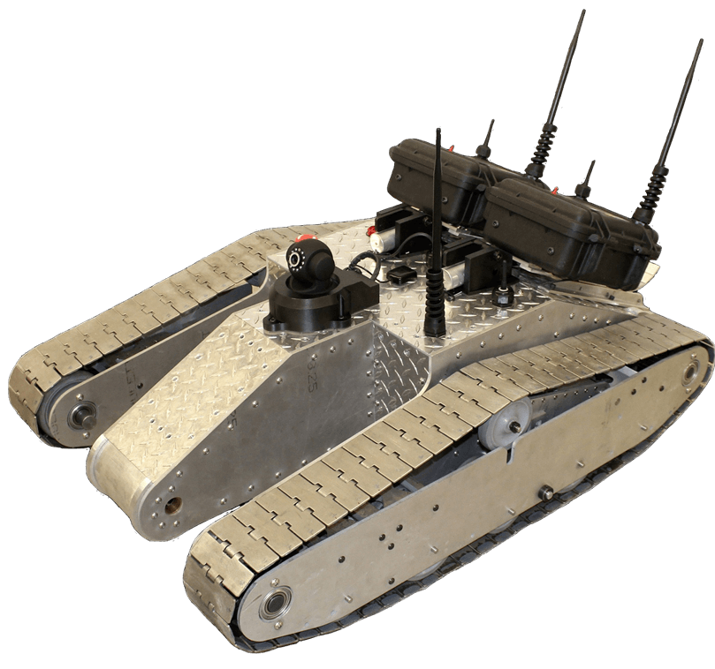
Wi-Fi Military Applications

Slide 22

Wi-Fi Education Applications

Slide 23
Topic distribution
Presented By | Topic
Laiba Humayun khan | What is Wi-Fi? IEEE 802.11 And The Standards Body Wi-Fi Standards Internet vs Wi-Fi WLAN vs Wi-Fi
Maimoona khilji | Elements of Wi-Fi How Wi-Fi works? Wi-Fi topologies AP-based topology Peer-to-Peer topology Point-to-Multipoint bridge topology
Khurram Ali Dar | Applications of Wi-Fi: Automotive Smart Home Military Education

Slide 24
Thanks!

